Slide 1
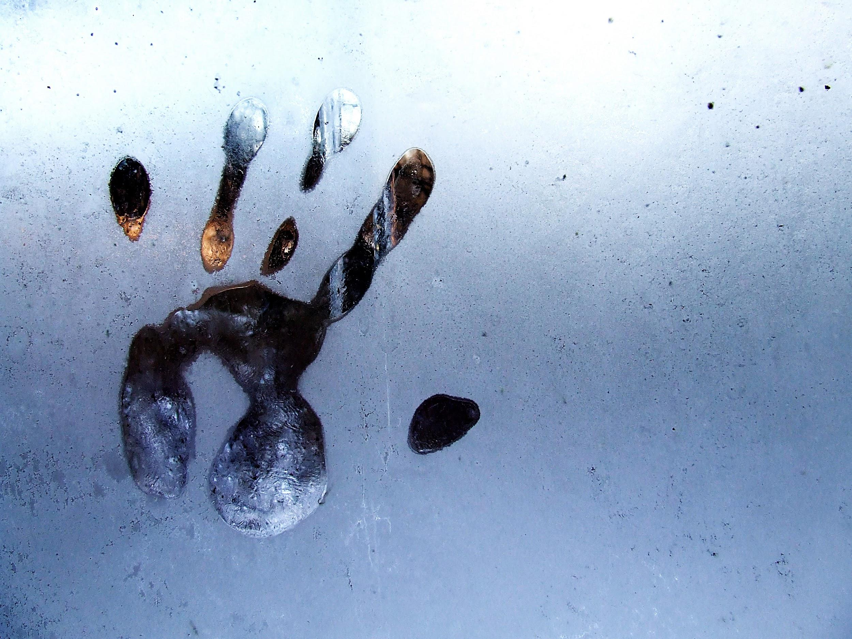
Do Afferent and Efferent Signals Separately Contribute to Hand Location Estimates?
Marius ’t Hart, Maria Ayala, Denise Henriques
CAPnet 2019

Slide 2
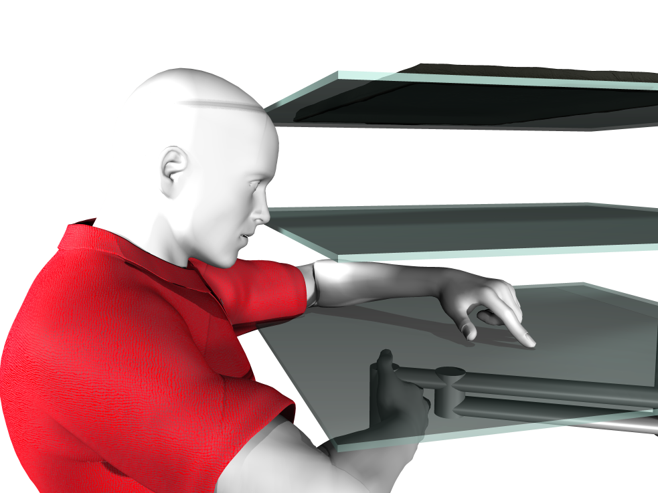
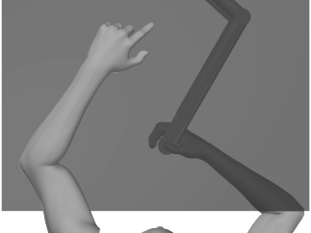
Where's my hand?
Accurate hand position estimates are important for movement
We use:
Usually, but not here: Visual signals
other Afferent signals (“proprioception”)
Efferent signals (“prediction”)
Notes:
Efference signals: corollary discharge, or copy of the motor command.
How do we measure where people think their hand is: explain setup and basic task.

Slide 3
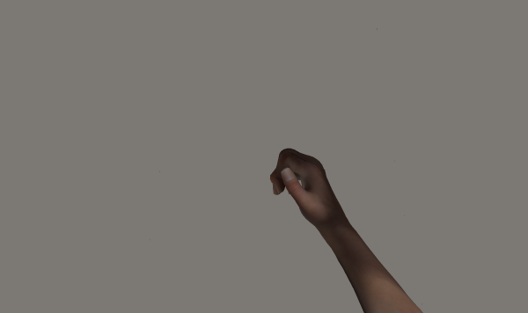
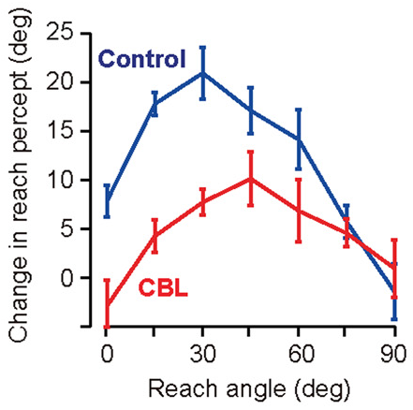
Cerebellum predicts
motor
command
efference
copy
cerebellum
prediction
-15
passive
active
-10
localization shift [°]
-5
0
15
25
35
45
55
65
75
hand angle [°]
(Izawa et al., 2012)
(’t Hart & Henriques, 2016; Mostafa et al, under review)
Notes:
Where people think their hand is changes with rotated feedback training
Izawa study shows:
Generalization curve
Much larger effect for healthy controls: cerebellum / prediction plays a role
We can eliminate (at least reduce) predicted sensory consequences without lesions to the cerebellum

Slide 4
How do efferent and afferent signals combine?
Active = efferent & afferent
Passive = afferent
-15
passive
active
-10
active
localization
localization shift [°]
efferent
-5
afferent
0
15
25
35
45
55
65
75
hand angle [°]
hand location estimate
Jones et al., 2010; Jones et al., 2012; ’t Hart & Henriques 2016; Mostafa et al., under review
Notes:
IF we can do reverse MLE, using active and passive localization tasks, we could get a pretty good guess at where efference-based predictions tell us our hands are. Which would be awesome.
BUT, in 4 papers so far: variance of active and passive localization doesn’t follow requirements for MLE / Bayes optimal observer

Slide 5
More data
In a series of experiments on the effect of explicit learning on hand localization, we kept the aligned session exactly identical.
161 participants
72 trials in both active and passive localization
Shanaathanan Modchalingam, Chad Vachon, Raphael Gastrock & Holly Clayton
Notes:
BUT, those papers needed means, and accurate estimates of variance just need more data, so….

Slide 6
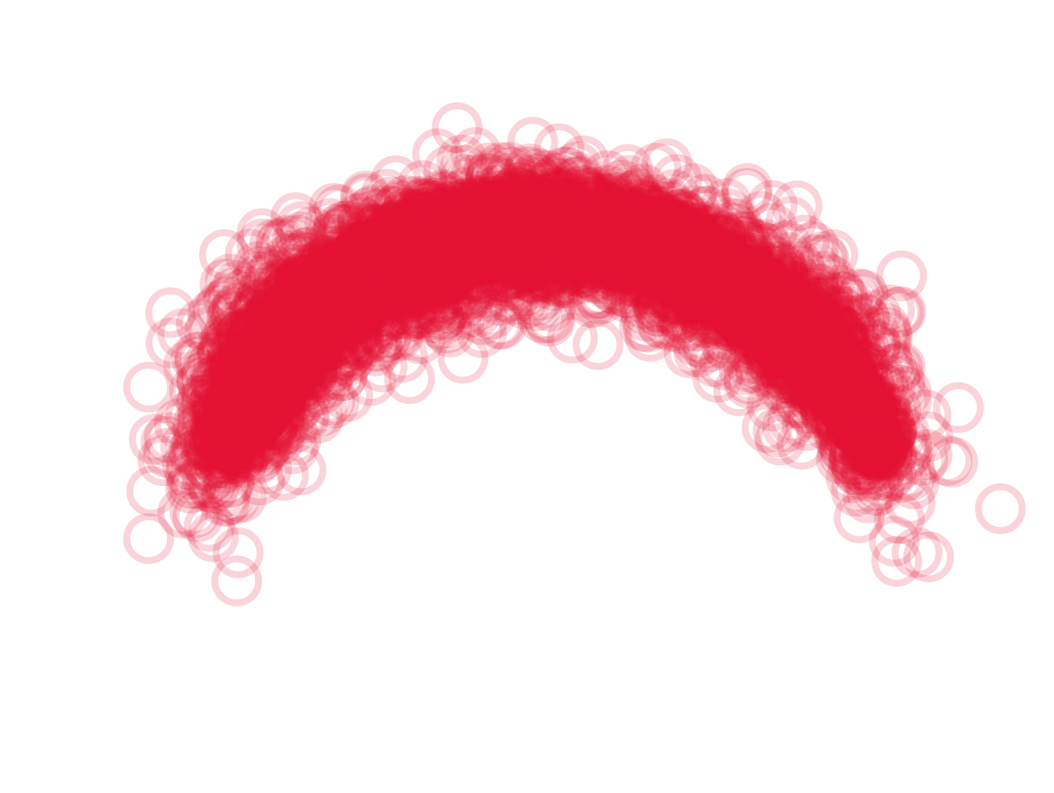
Where do people point?
active
passive
90°
90°
135°
45°
135°
45°
180°
0°
180°
0°
(10186 responses)
(10782 responses)
Notes:
People can touch a visible arc with their visible left hand! Amazing.
Also: 10,000 selected datapoints per condition. (72 * 161 = 11,592, removed obvious mismearements)

Slide 7
Systematic biases
30
localization error [°]
0
-30
0
45
90
135
180
hand angle [°]
30
localization error [°]
0
-30
0
45
90
135
180
hand angle [°]
Notes:
There are systematic biases: given a hand angle, people will have some bias in their hand location estimate.
Interesting but not for this question: we estimate the systematic part of the errors with smoothed splines and subtract them from the data.

Slide 8
Certainty with one or two signals
15
10
σ
passive
5
0
0
5
10
15
active
σ
Notes:
(un)certainty about hand location is equivalent in both tasks
Remove the regression? Stress the equivalence test?
87/161 (p=.344)
slope=0.989
r=0.993 (p<.001)

Slide 9
What now?
Does the brain do simple addition? Probably not.
Maybe there’s a more sensitive task to assess predicted sensory consequences?
We’d love your feedback!
Notes:
Here’s where we’re not sure where to go next...

Slide 10
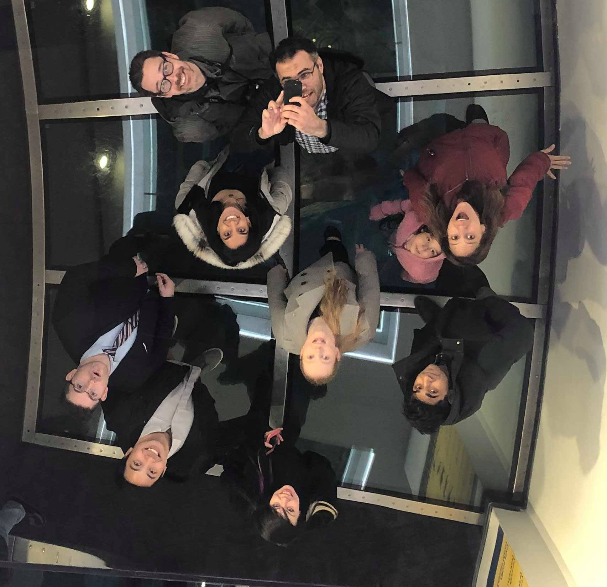
Thanks!
Lab:
Shanaathanan Modchalingam
Chad Vachon
Raphael Gastrock
Holly Clayton
Maria Ayala
Jennifer Ruttle
Ambika Bansal
Ahmed Mostafa
Denise Henriques
Funding:

