Slide 1
Neural markers of movement preparation and outcome during motor adaptation and de novo learning tasks
Presenter: Raphael Q. Gastrock
Co – authors: Edward Ody, Denise Y. P. Henriques, & Bernard Marius ’t Hart
SCAPPS 2023 Conference
October 13, 2023

Slide 2
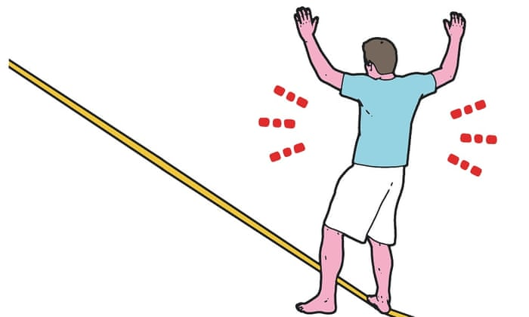
Types of motor learning
De novo learning
Motor adaptation
walking on slack line
modifications to walking on slack line

Slide 3
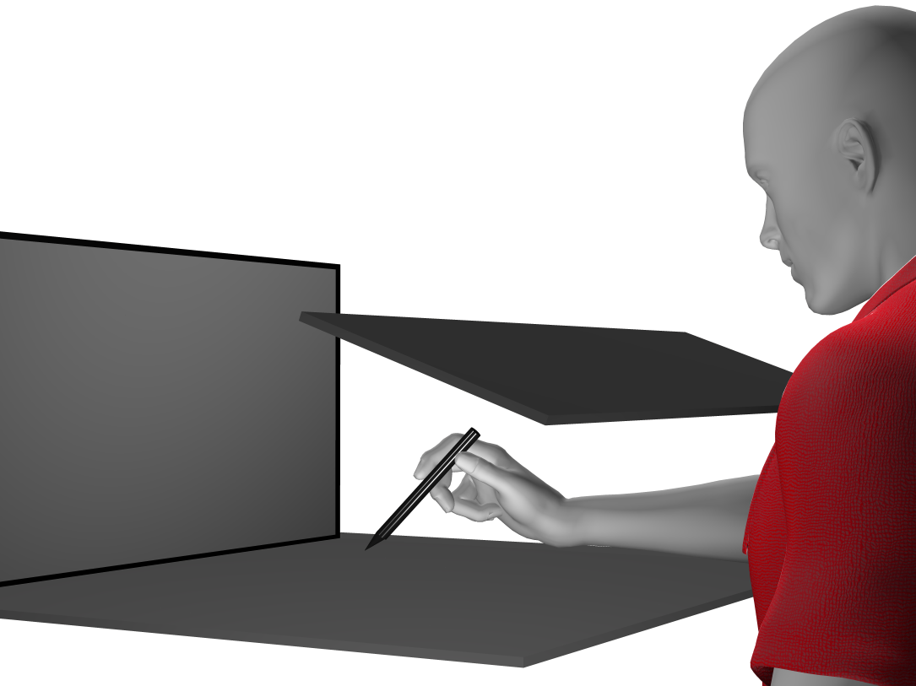
occlude vision of hand
monitor
tablet + stylus

Slide 7
Types of motor learning
(Adaptation)

Slide 10
Types of motor learning
(Adaptation)
(De novo learning)
Aligned cursor
Training with perturbation
Aligned cursor
(washout)

Slide 11
Behavioral results
Reaches across perturbation trials
Reaches across washout trials
200
200
Visuomotor rotation
Mirror reversal
100
100
0
0
Amount of compensation (%)
Amount of compensation (%)
-100
-100
-200
-200
1
5
10
15
1
3
6
8
Block
Block
Learning progressed quickly for both perturbations (within 90 trials)
Reach aftereffects were observed following visuomotor rotation training only

Slide 12
Behavioral results
Reaction times were slower for the mirror reversal, than the rotation task
800
600
Reaction time (ms)
400
200
Aligned
Rotation and Washout
0
Mirror and Washout
1
5
20
28
43
50
Behavioral results: Gastrock et al., 2023
Block

Slide 13
Research question
Given the different behavioral mechanisms underlying the two motor learning types, how are these represented in the brain?
Hypothesis:
Different neural (EEG) markers will be associated with each learning type during movement preparation and feedback error-processing.

Slide 14
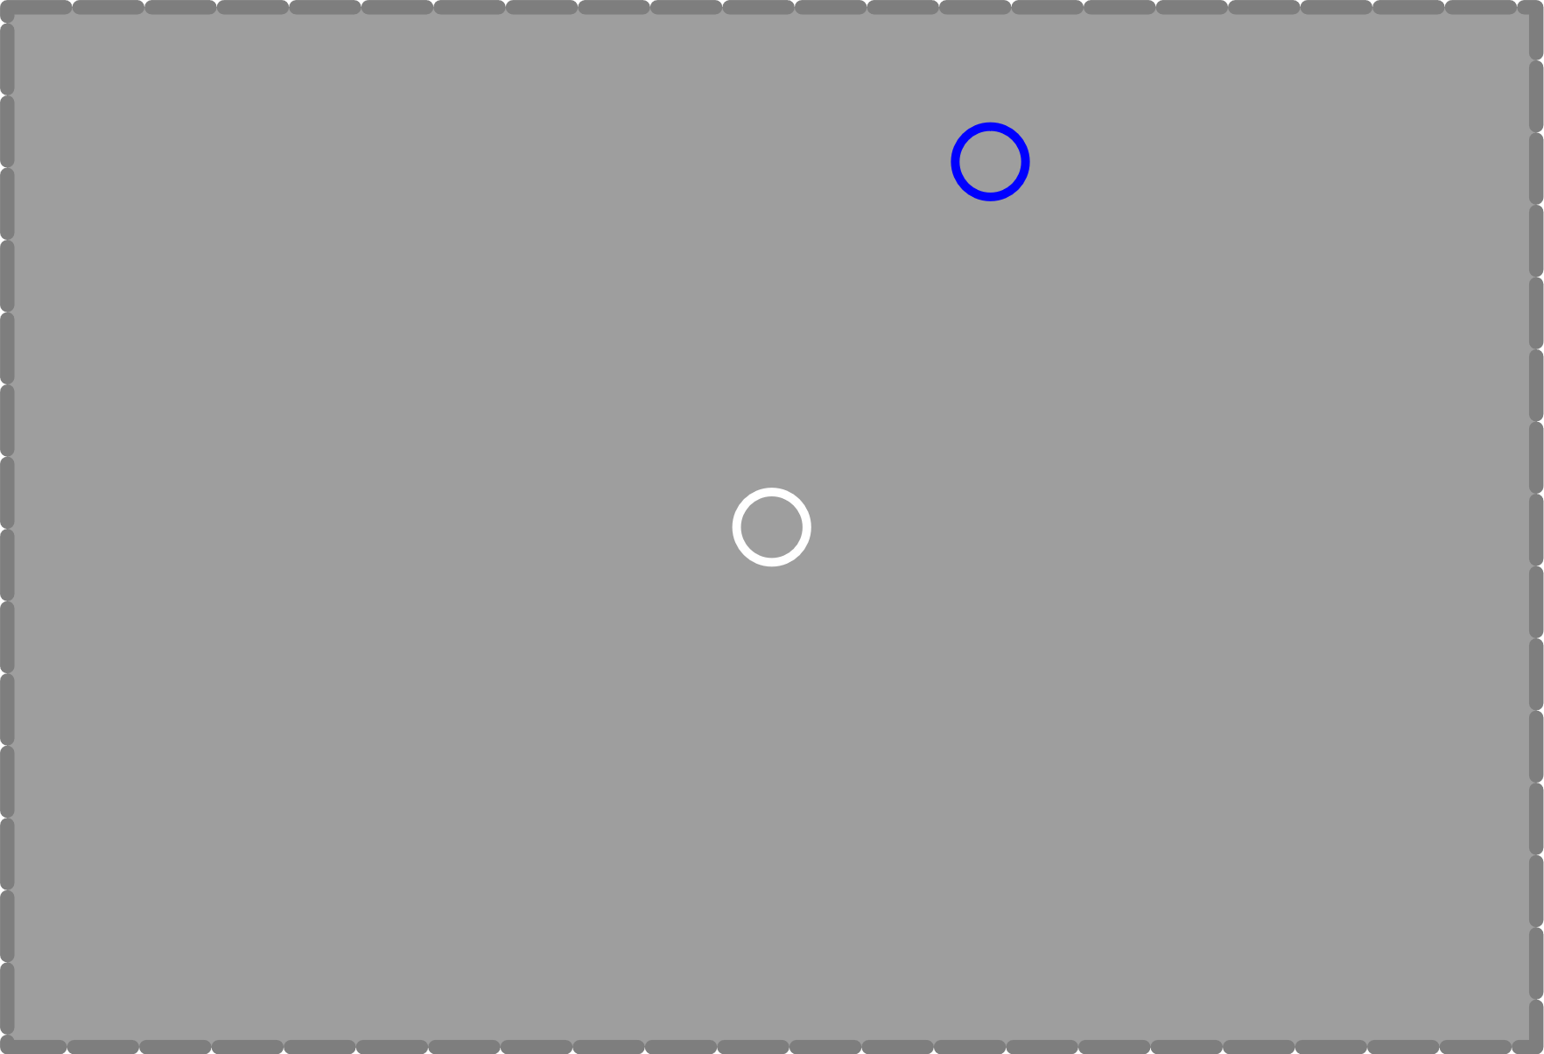
Investigating neural mechanisms
feedback (1s)
go signal (after 1s)
N = 32
Investigate Event Related Potentials (ERPs)
Feedback onset
Event Related Negativity (ERN)
Feedback Related Negativity (FRN)
P3 component
Movement preparation
Readiness potential
hold home (300 ms)
-> cue target position
move white cursor to home
Notes:
Mention that we have long hold periods (1s) to remove movement artifacts

Slide 15
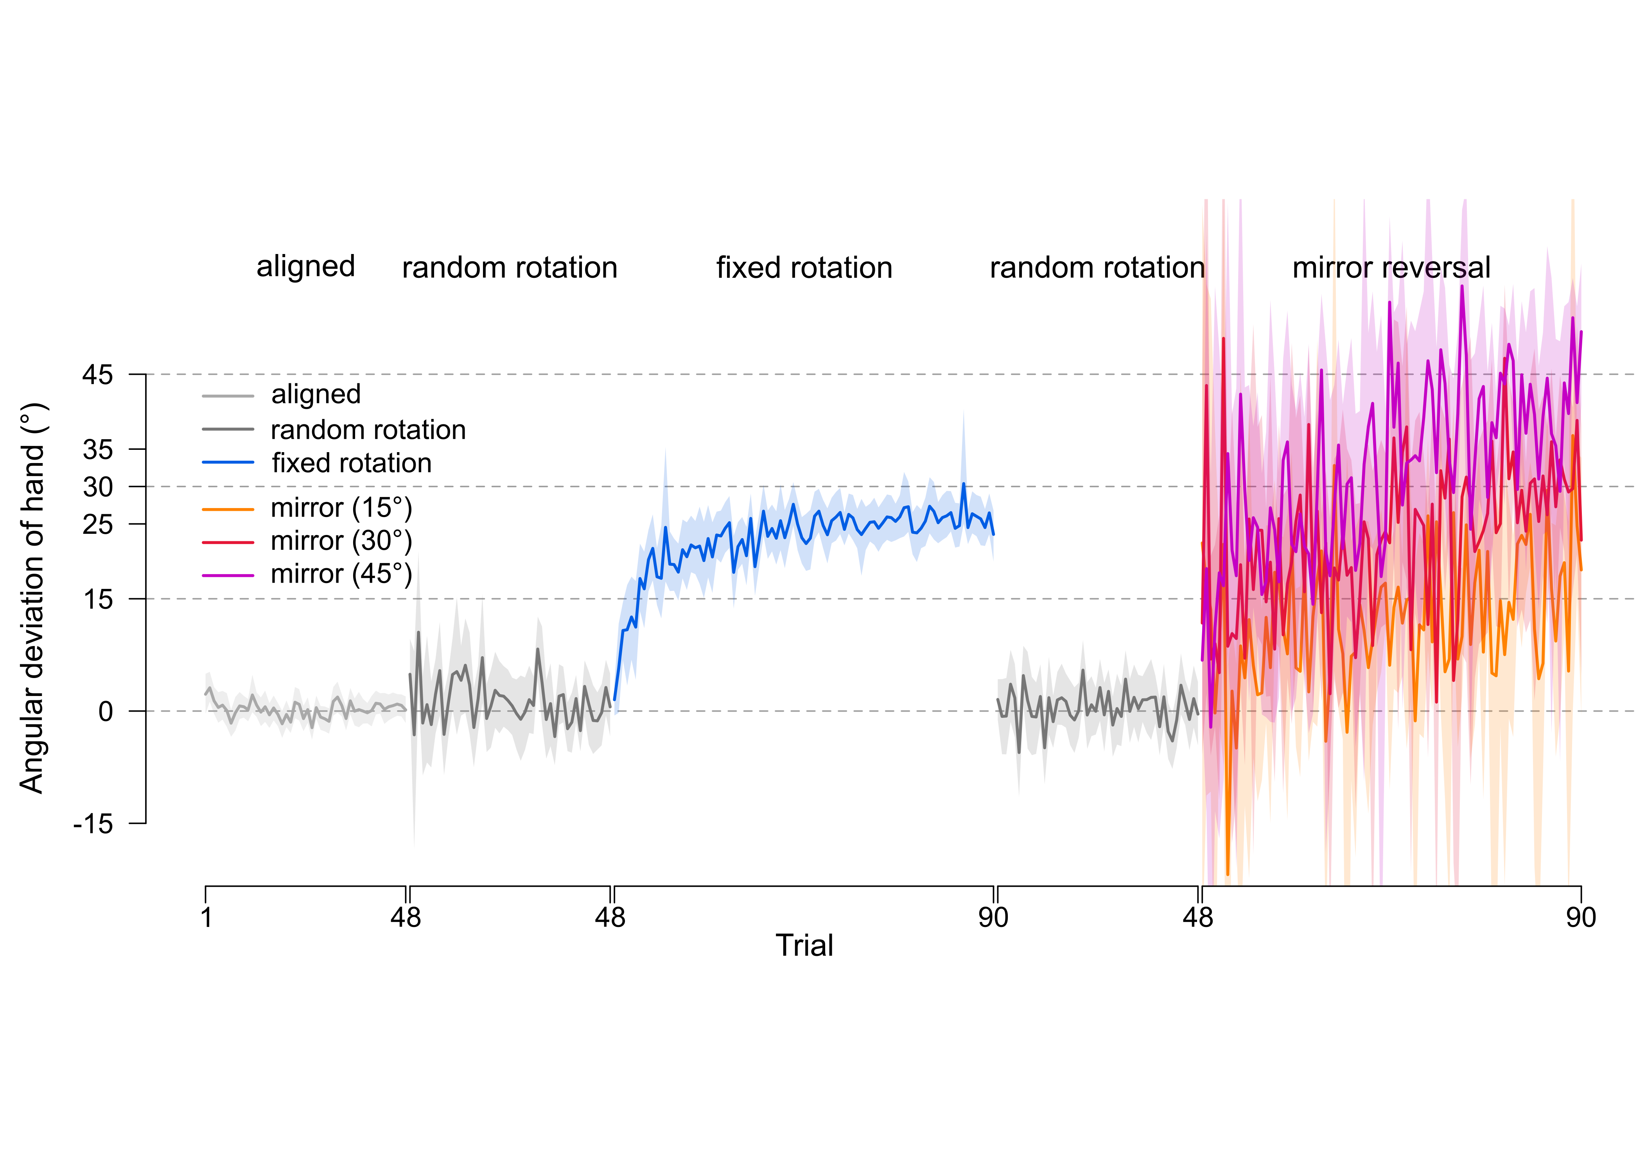
Feedback onset
Split reach data according to error magnitude
ERN: during movement, reflects prediction of movement outcome
FRN: after feedback onset, indicates movement success

Slide 16
Feedback onset
Fixed rotation
ERP component peaks before feedback onset, and is less negative for aligned trials

Slide 17
Feedback onset
Mirror reversal
ERP component peaks before feedback onset, and is less negative for aligned trials

Slide 18
Feedback onset
Random rotation
ERP component peaks before feedback onset, and is less negative for aligned trials
ERP peak amplitude does not scale to perturbation type nor error magnitude

Slide 19
Attention allocation
P3 is a positive-going component elicited 200-600 ms post-stimulus
Here, we time-lock to feedback onset
Two subcomponents (as in Lazar-Kurz et al., 2023):
P3a: increased amplitude reflects increased focal attention (~ 150 to 280 ms post-stimulus)
P3b: integration of stimulus information into individual’s inner working model of the external environment (~ 280 to 500 ms post-stimulus)
Explore P3a and P3b components across training trials

Slide 20
Attention allocation
ERP time-locked to feedback onset
P3a
P3b
feedback
onset
5
0
µV
-5
Aligned
-10
Rotation: 1st block
Rotation: last block
-15
-1.50
-1.00
-0.50
-0.25
0
0.15
0.50
1.00
1.50
0.28
Time (s)

Slide 21
Attention allocation
ERP time-locked to feedback onset
P3a
P3b
feedback
onset
5
0
µV
-5
Aligned
-10
Mirror: 1st block
Mirror: last block
-15
-1.50
-1.00
-0.50
-0.25
0
0.15
0.50
1.00
1.50
0.28
Time (s)

Slide 22
Attention allocation
ERP time-locked to feedback onset
P3a
P3b
feedback
onset
5
0
µV
-5
Aligned
-10
Random: 1st block
Random: last block
-15
-1.50
-1.00
-0.50
-0.25
0
0.15
0.50
1.00
1.50
0.28
Time (s)

Slide 23
Attention allocation
P3a across learning
P3b across learning
aligned
random rotation
fixed rotation
10
10
mirror reversal
5
5
2.5
2.5
µV
0
0
-2.5
-2.5
-5
-5
-10
-10
pre-training
1
2
3
4
5
pre-training
1
2
3
4
5
Training blocks
Training blocks
Larger P3a component after feedback onset in perturbed conditions

Slide 24
Movement preparation
ERP time-locked to feedback onset
P3a
P3b
feedback
onset
5
0
µV
-5
Aligned
-10
Rotation: 1st block
Rotation: last block
-15
-1.50
-1.00
-0.50
-0.25
0
0.15
0.50
1.00
1.50
0.28
Time (s)
Readiness potential indicates pre-movement planning
Notes:
RP around motor or pre-SMA areas

Slide 25
Movement preparation
Readiness potential depends on prepared movement direction
Thus, we can calculate a Lateralized Readiness Potential (LRP) and use it as a measure of preparatory activity in the upcoming movement:
LRP = (right C3 – right C4) – (left C3 – left C4)
More negative LRP, more preparatory activity

Slide 26
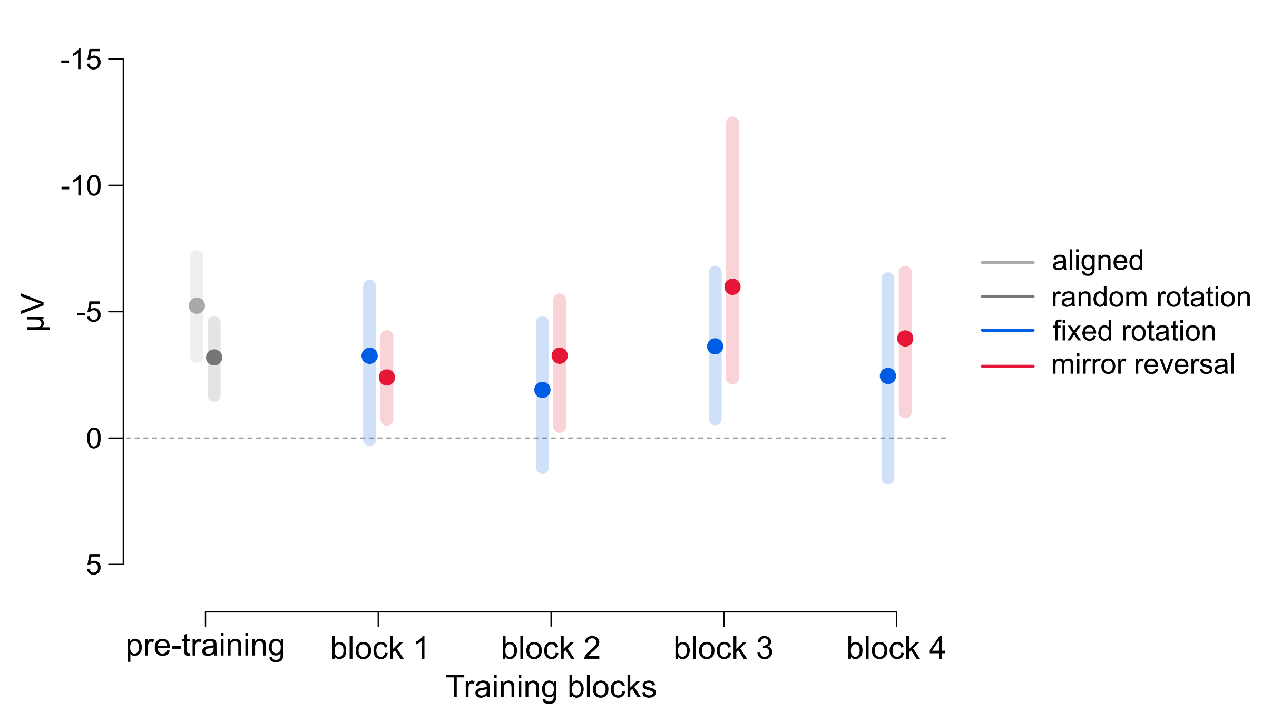
Movement preparation
LRPs were less pronounced for the perturbed conditions than in aligned reaches
No LRP differences between mirror and rotation perturbations

Slide 27
Conclusions
ERPs reflect movement preparation, attention allocation, and error processing in motor learning tasks
However, ERP measures do not seem to distinguish between motor adaptation and de novo learning
Future directions
Time – frequency analyses (e.g. error-related beta desynchronization)
Other EEG markers

Slide 28
Thank you for your attention!
Contact: raphaelgastrock@gmail.com
@rqgastrock
Sensorimotor Control Lab

Slide 29
Supplementary

